Slide 1
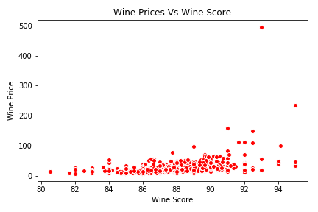
Correlation between Price & Score of a Wine by Variety
While there is a clear trend: the higher a rating of a wine an average price, it could be explained by subjective appreciation, it means people tend to rank higher more expensive wines. As the pleasure people get from consuming wine depends both on its intrinsic qualities such as taste and smell and external attributes such as price and presentation.

Slide 2
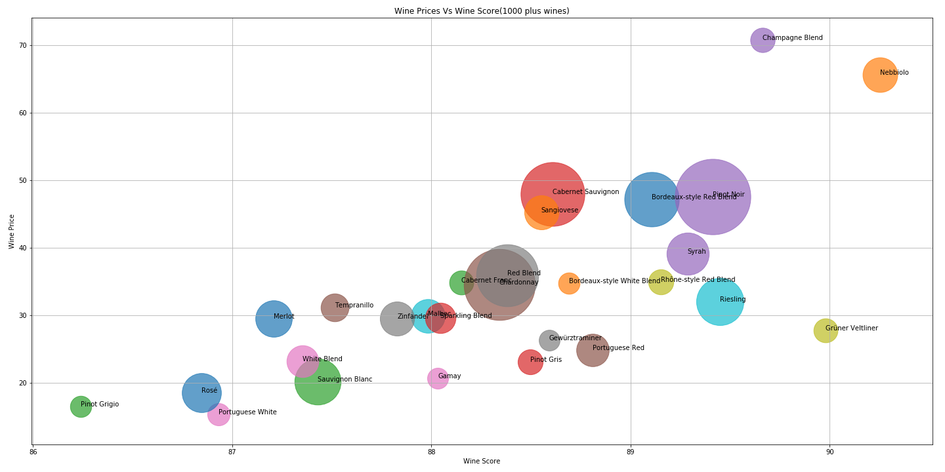
Correlation between Price & Score of a Wine by Variety

Slide 3
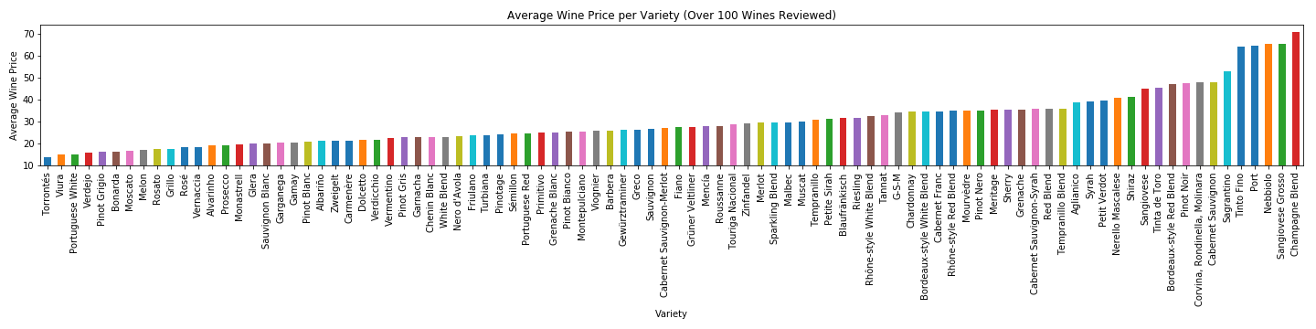
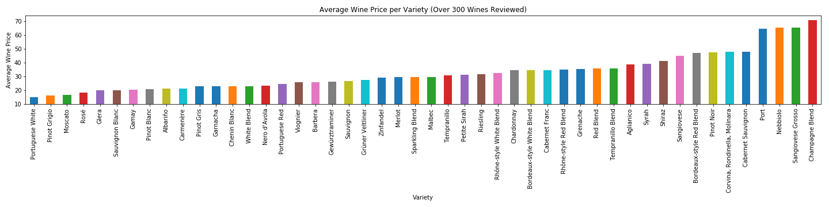
Average Price Vs Variety of Wine
Champagne Blend are the costliest

Slide 4
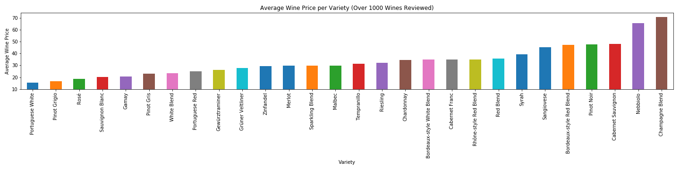
Average Price Vs Variety of Wine
Champagne Blend are the costliest followed by
Nebbiolo
Cabernet Sauvignon
Pinot Noir

Slide 5
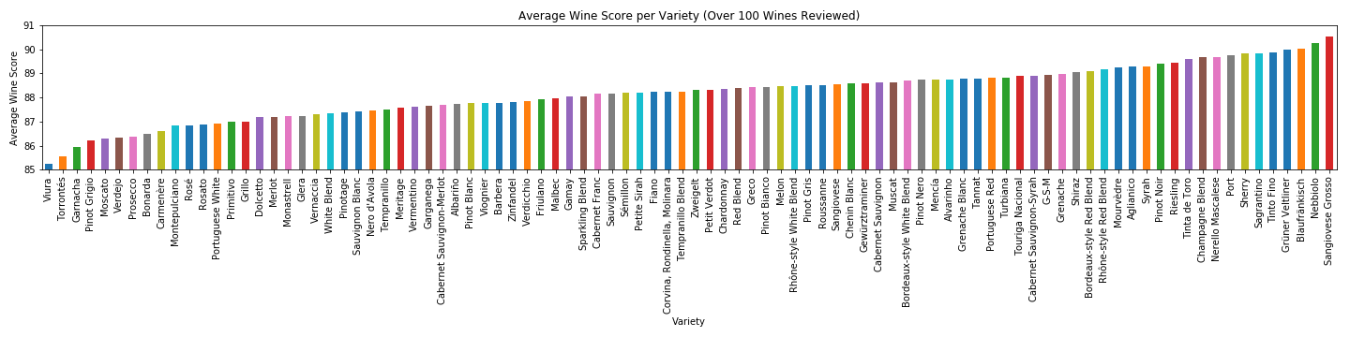
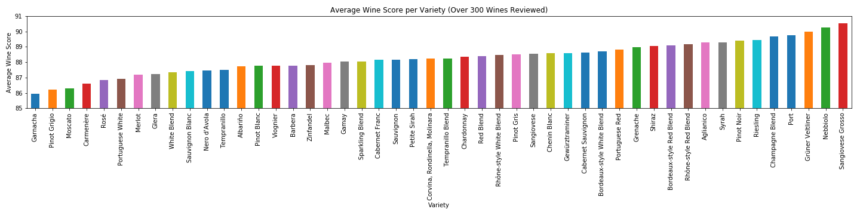
Average Score Vs Variety of Wine
Sangiovese Grosso has the highest score. Sangiovese is a red Italian wine grape variety that derives its name from the Latin sanguis Jovis, "the blood of Jupiter"

Slide 6
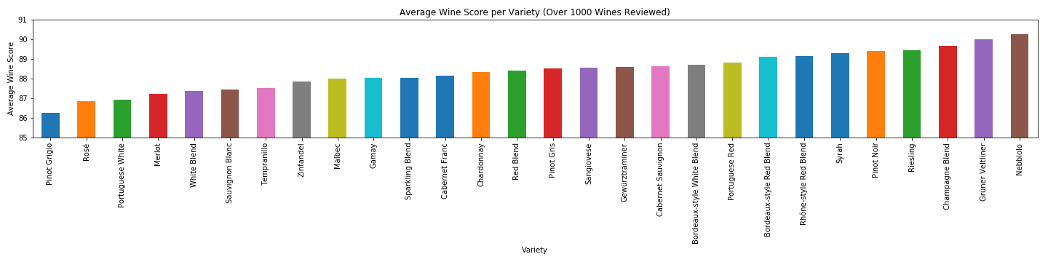
Average Score Vs Variety of Wine
In Wine Varieties having more than 1000, Nebbiolo has the highest score. Nebbiolo, or Nebieul is an Italian red wine grape variety predominantly associated with its native Piedmont region, where it makes the Denominazione di Origine Controllata e Garantita wines of Barolo, Barbaresco, Roero, Gattinara and Ghemme

